Slide 1

Ecommerce Business Report
By Team A
www.reallygreatsite.com

Slide 2

01
INTRODUCTION
The presentation analyses historical data for an ecommerce business with steady but declining sales. It aims to uncover insights into customer behaviour, revenue drivers, and risks to deliver actionable recommendations for better retention, profitability, and growth.

Slide 3

02
RELEVANT BUSINESS QUESTIONS
Are we retaining customers or constantly replacing them?
Which customers and regions drive the most value?
Which products generate profit vs losses?
Where are operational failures hurting customer experience?
Why are sales, orders, and profits declining over time?

Slide 4
04
CUSTOMER GROWTH & RETENTION
Strong growth in late 2023/early 2024, stable active customers through most of 2024–2025.
Sharp decline in late 2025 reveals a retention problem hidden by new acquisitions → "leaky bucket" effect with high churn and marketing costs.

Slide 5
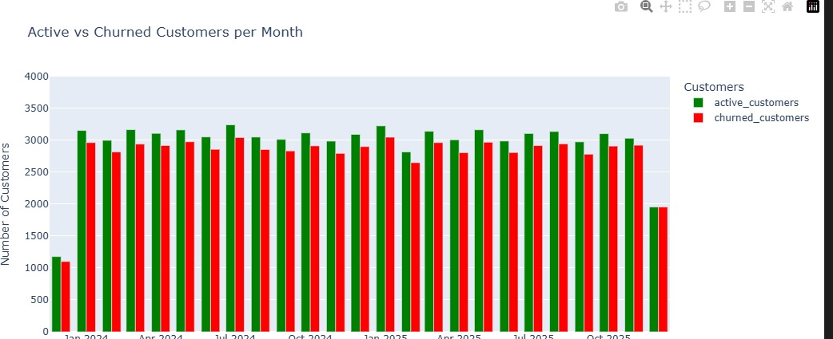
05
CHURN DRIVERS
Consistently high monthly churn, worsened in late 2025.
Lower credit tiers, high shipping costs, long delivery times drive churn the most.
Newsletter subscribers retain better; age is not a significant factor.
Payment/delivery friction and engagement outweigh demographics.

Slide 6
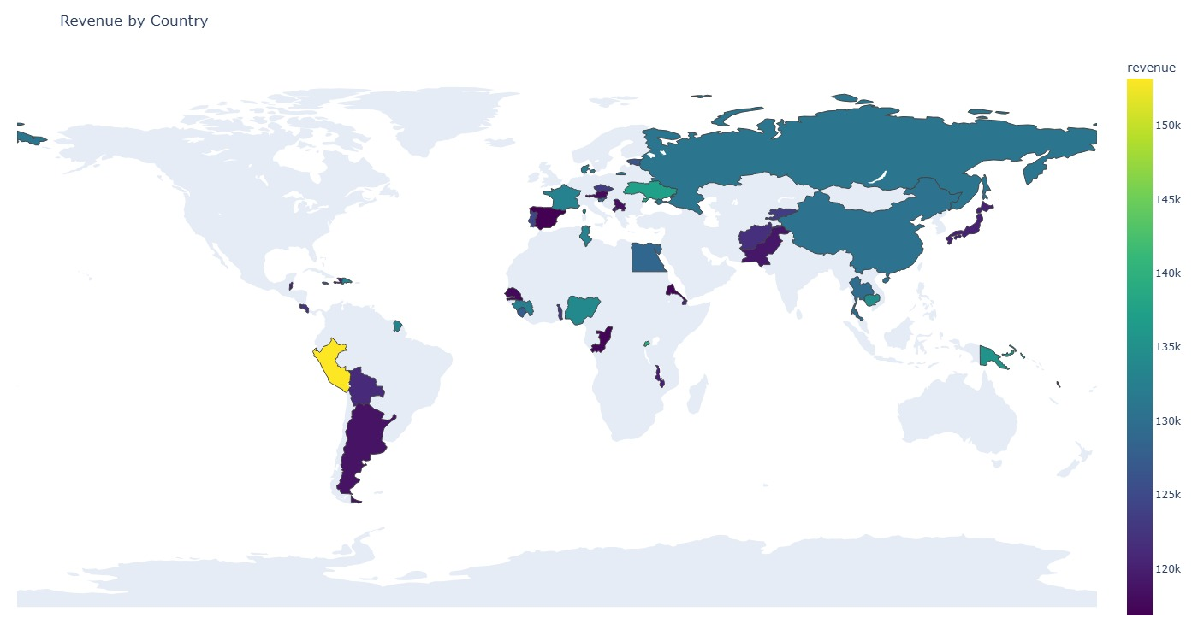
04
REGIONAL PERFORMANCE
Revenue spreads globally; no dominant country.
Small markets (e.g., Bahrain, Barbados) yield high revenue per customer.
Large markets (e.g., China, Nigeria) have volume but low spend per user → Opportunity: Upsell in high-volume markets.

Slide 7
04
HIGH-VALUE CUSTOMERS
Top 10% spend similarly; no reliance on outliers, but losing any hurts revenue significantly → Action: Add premium loyalty benefits.
Highest LTV from high credit tier + newsletter subscribers.
Purchase frequency alone does not ensure value; quality over quantity matters.

Slide 8
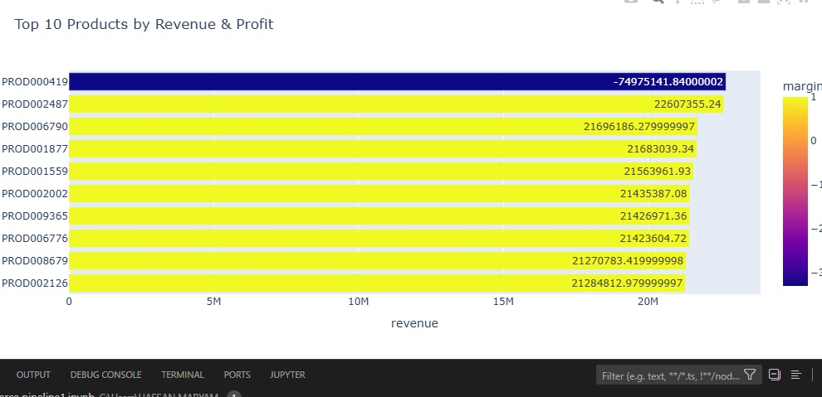
04
PRODUCT PERFORMANCE
Some products drive high revenue/profit (strengths).
One product shows massive negative revenue (major risk).
Low-rated products still sell well (quality fixable); others need inventory clearance.

Slide 9
04
OPERATIONAL ISSUES
Delivery: No strong speed-rating correlation overall, but extreme delays cause poor ratings. All warehouses at ~65% success (systemic issue, below industry standards).
Payments: Cash/PayPal highest failures; digital wallets (Apple/Google Pay) perform best → Promote reliable methods.

Slide 10
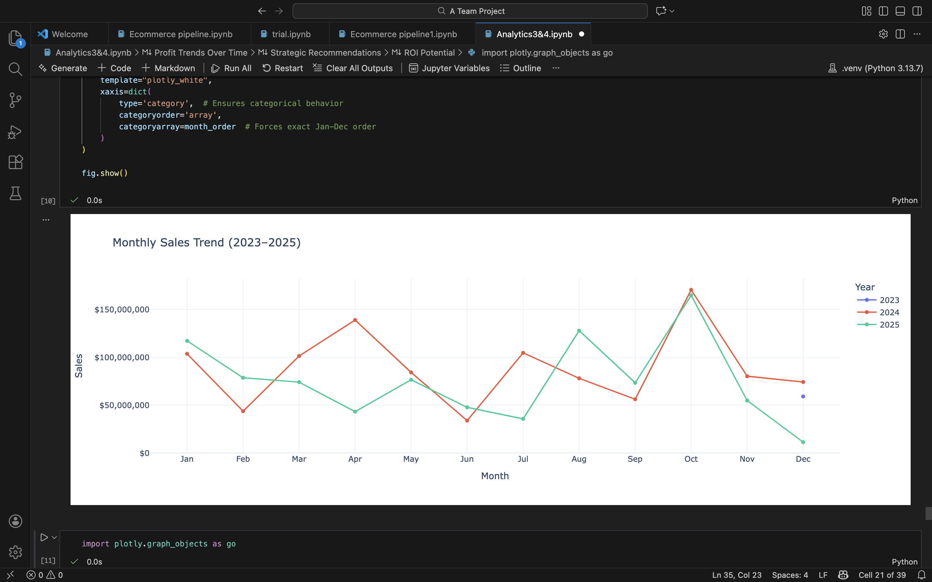
04
TRENDS OVER TIME
No 2023 data (pre-launch?); 2024 peak, then steady decline in sales, orders, and profits through 2025.
No seasonal recovery; margins shrink; revenue roughly halved from peak.

Slide 11
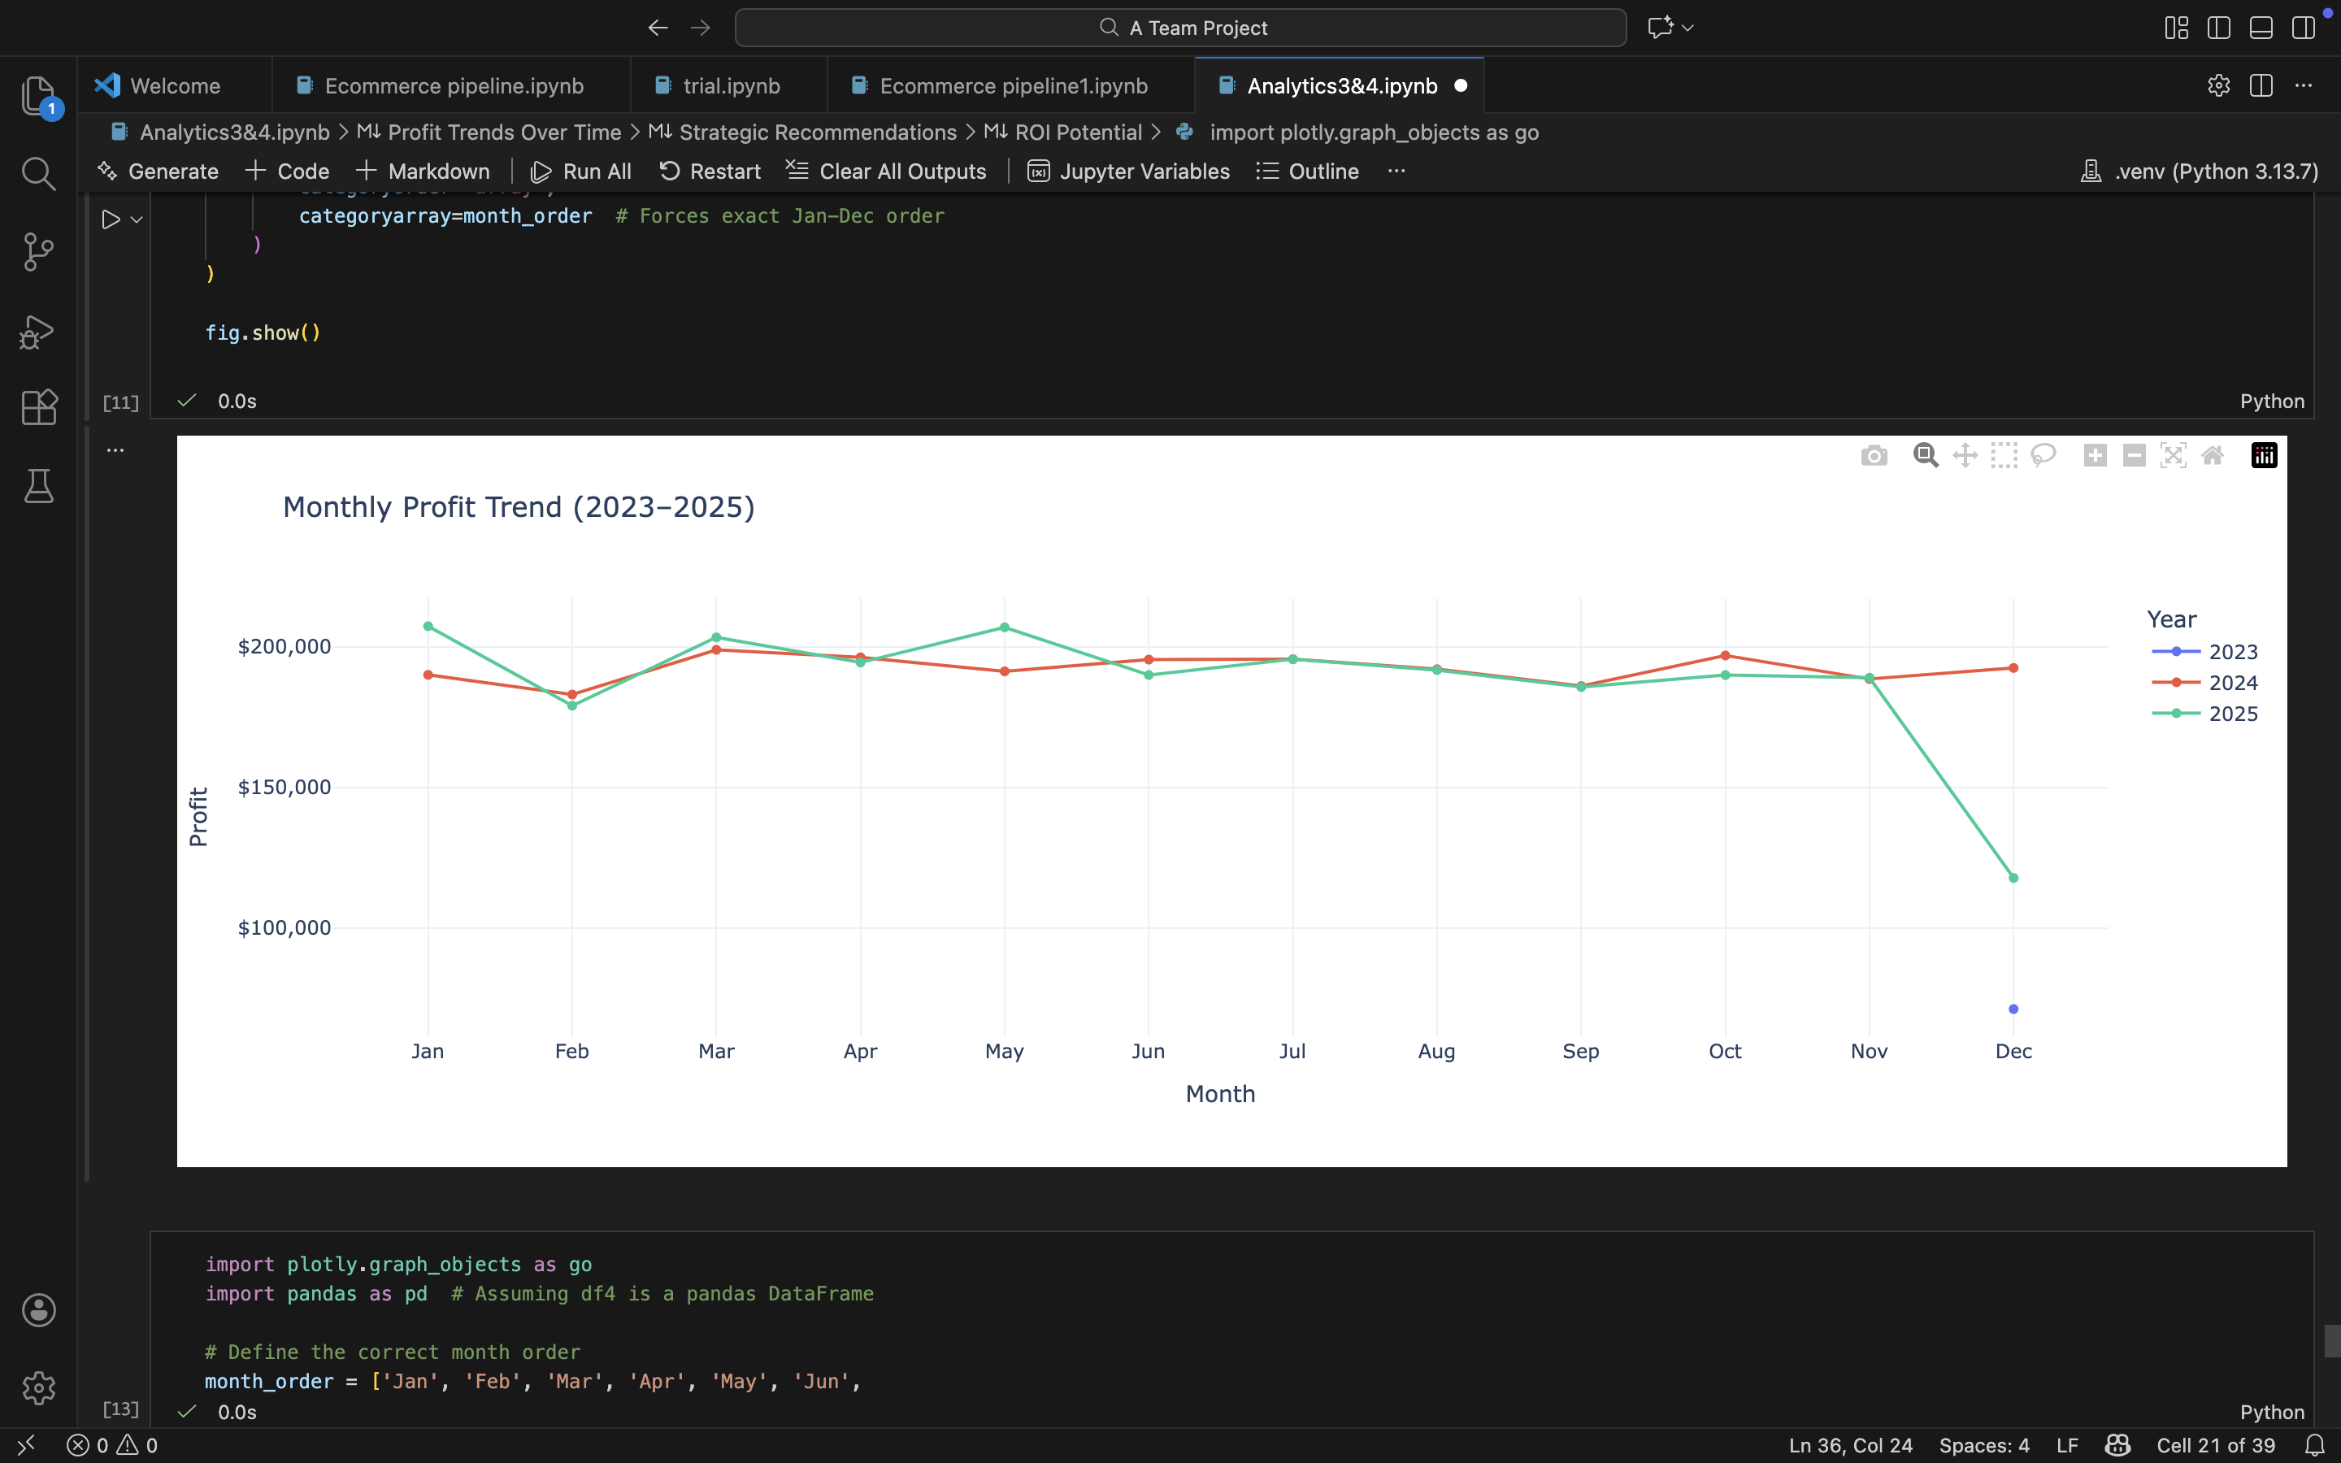
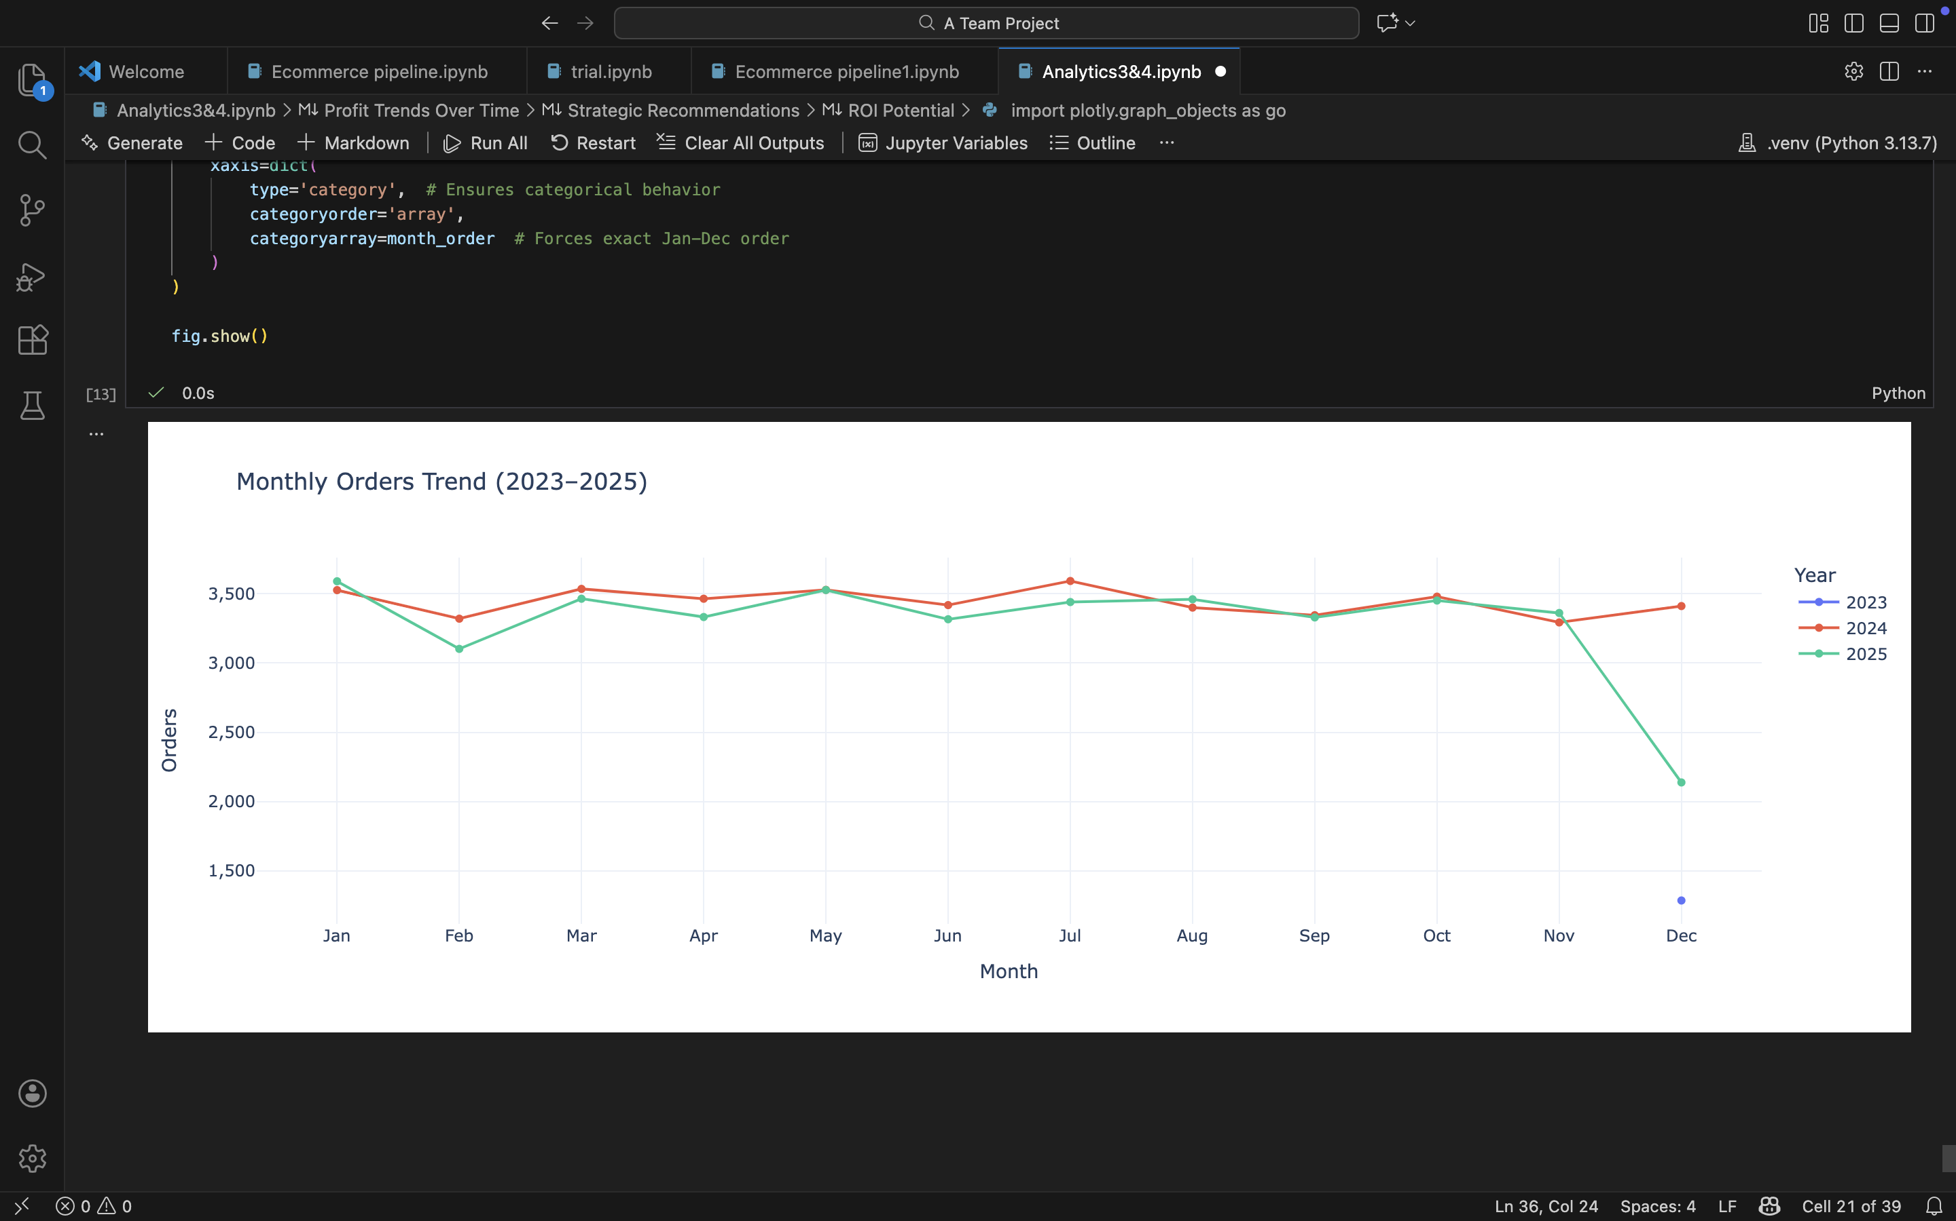
04
TRENDS OVER TIME

Slide 12
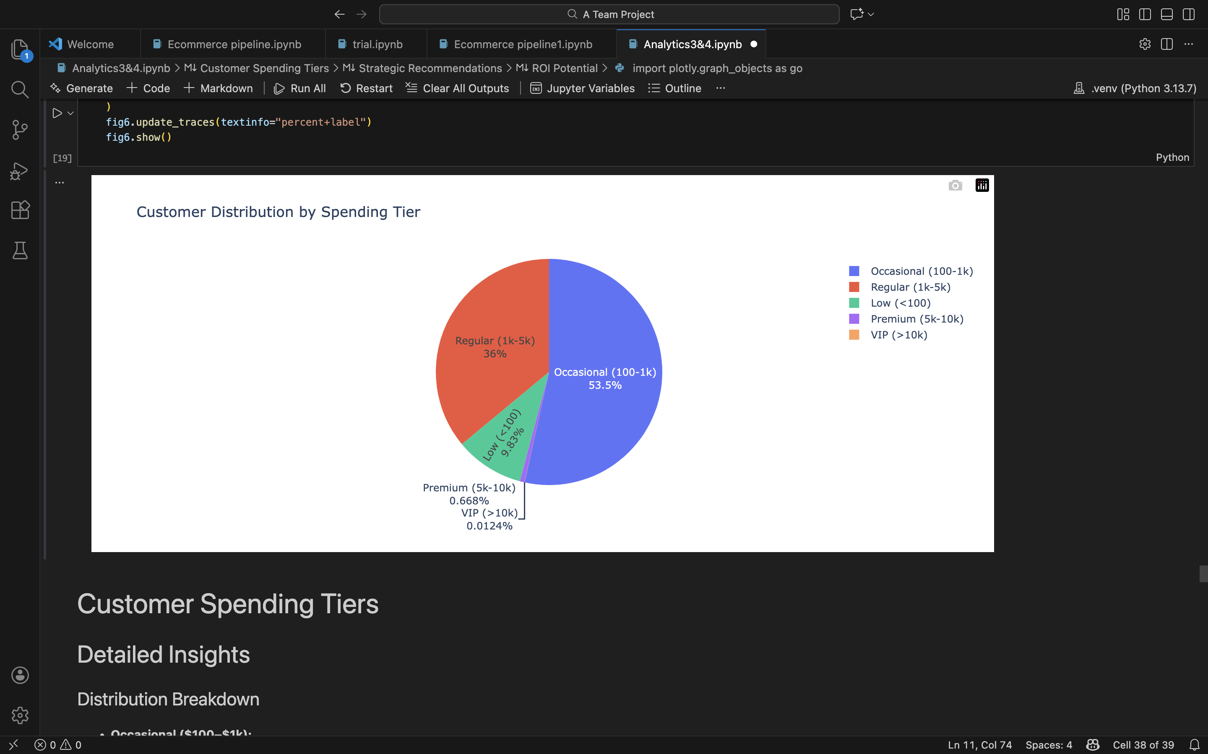
04
CUSTOMER SPENDING
Over 50% are low/occasional spenders; <1% premium/VIP.
Higher spenders retain longer and add more value → Action: Incentives to upgrade tiers.

Slide 13
04
WHAT THIS MEANS FOR THE BUSINESS
Persistent high churn
Declining sales/profits/orders
Operational failures (delivery/payment)
Product quality/returns
Over-reliance on low-value customers/regions

Slide 14



06
WHAT NEEDS TO CHANGE
Shift strategy from acquisition-first → retention-first
Fix fulfillment reliability and reduce failed deliveries
Actively move customers up spending tiers
Protect and prioritize high-LTV and premium customers
Eliminate loss-making products and improve quality issues

Slide 15
THANK YOU
www.reallygreatsite.com

